Slide 1


Department of Electronics and Communication Engineering
B.E – ECE( 3rd Year B)
Crop Protection System
Domain: ARM
Presented By |  | Under the Mentoring of
Shrinidhi S Ramyapriya V | 23EC145 23EC113
 |  | Assistant Professor / ECE department

Slide 2
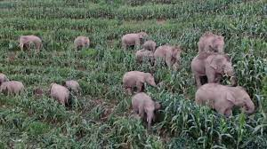
PROBLEM STATEMENT
Wild animals frequently invade farmlands, causing severe crop damage and financial losses for farmers.
Traditional methods like fencing are often ineffective — animals can jump over or break through them.
Use of electric fences or harmful traps is illegal and unsafe for animals and humans.
There is a critical need for a non-harmful, intelligent, and automated system that can detect animal intrusions and protect crops, especially during nighttime when human monitoring is not possible.
Chennai Institute of Technology | B.E | ECE | Zeroth Review | 8/4/2025 | 2

Slide 3
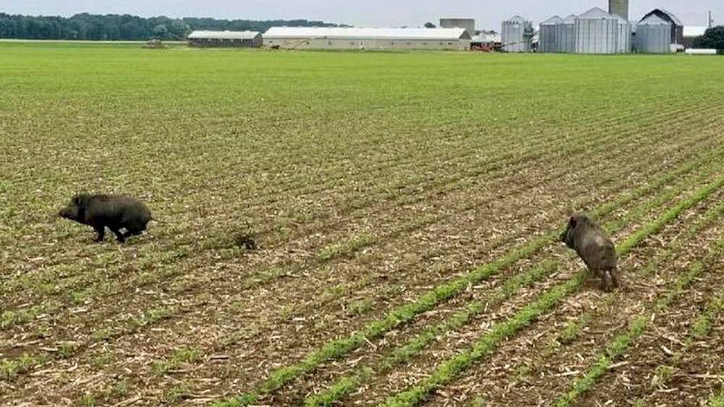
SOLUTION
Uses a thermal imaging sensor (MLX90640) to detect animals based on their body heat — effective even in nighttime or low visibility.
STM32 microcontroller processes real-time data to identify intrusions intelligently.
When an animal is detected, the system plays high-frequency sound via DFPlayer Mini & speaker to scare animals without harming them.
Optionally logs events to an SD card for later analysis.
Sends wireless alerts to the farmer using a LoRa module, even in remote areas.
Entire setup is solar-powered and energy-efficient, making it ideal for off-grid farms.
Chennai Institute of Technology | B.E | ECE | Zeroth Review | 8/4/2025 | 3

Slide 4

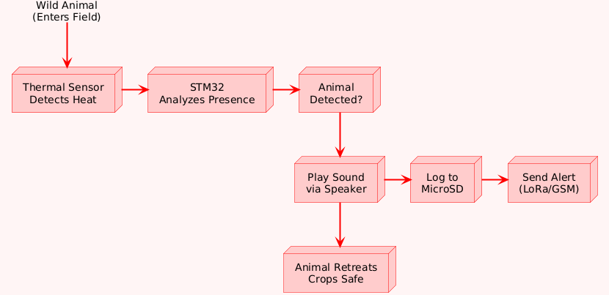
WORKING
Animal Enters Field
A wild animal crosses into the crop area.
2. Thermal Sensor Detects Presence
MLX90640 senses the animal’s body heat.
3. STM32 Processes Sensor Data
Microcontroller analyzes thermal input to confirm movement/shape.
4. Animal Detection Confirmed
If an animal is detected based on heat pattern → trigger response.
5. Sound Deterrent is Activated
DFPlayer Mini plays a specific frequency sound through speaker to scare the animal away (non-harmful).
6. Event is Logged
Detection and time are optionally saved to a microSD card for record-keeping.
7. Farmer is Alerted
LoRa/GSM module sends an alert message to the farmer’s mobile device.
8. Animal Retreats Safely
The animal is scared off without harm, and crops remain protected.
Chennai Institute of Technology | B.E | ECE | Zeroth Review | 8/4/2025 | 4

Slide 5
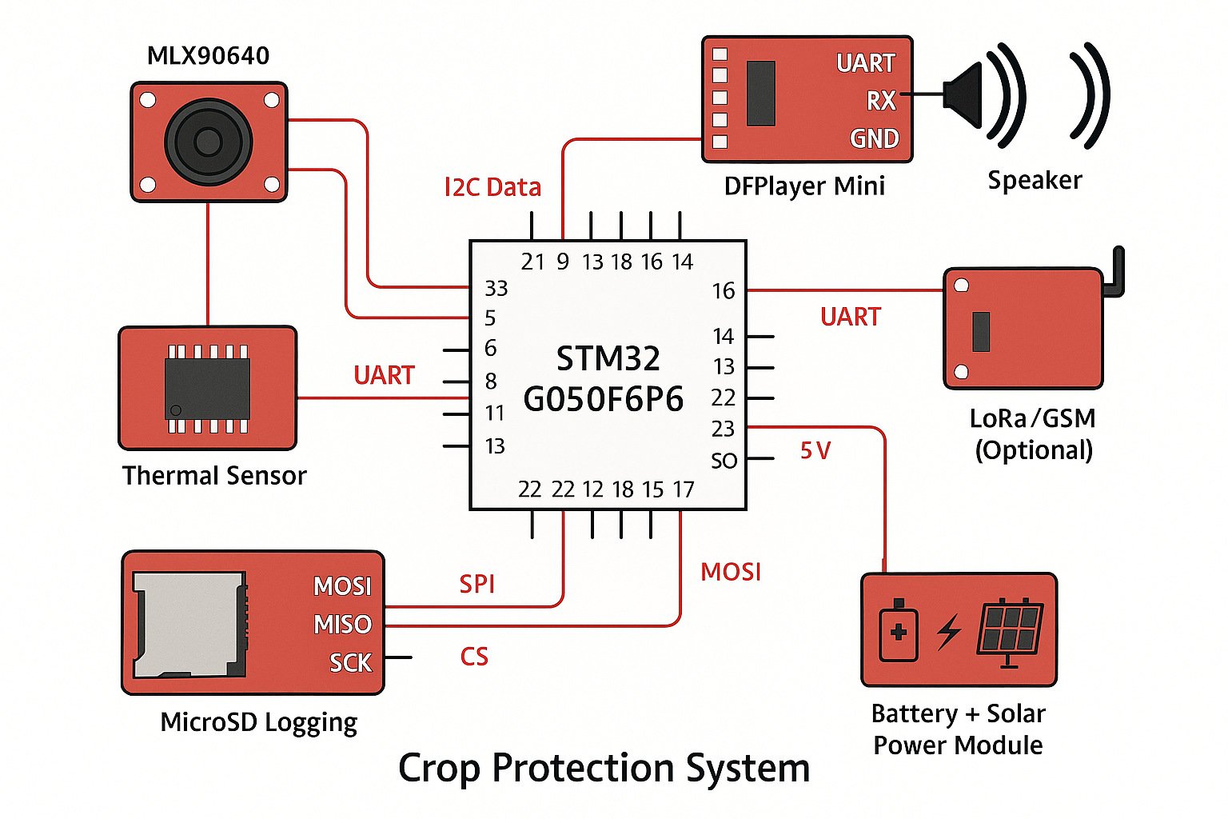
REQUIRED HARDWARE
S. No | Components name | Specification
1. | STM32G050F6P6 (MCU) | 32-bit ARM Cortex-M0+, 64 KB Flash, 8 KB RAM, multiple UART/I2C/SPI
2. | MLX90640 Thermal Sensor | 32×24 IR array, I2C interface, detects body heat up to 7 meters
3. | DFPlayer Mini | MP3 player module, UART controlled, microSD support, speaker output
4. | Speaker | 3W/5V output, connected to DFPlayer Mini for sound playback
5. | MicroSD Card Module | SPI interface, stores log data (animal detection events)
6. | LoRa SX1278 / GSM Module | Long-range wireless communication (LoRa) or mobile alert (GSM), UART/SPI
7. | Battery + Solar Power Module | 3.7V Li-ion battery with 5V/3.3V regulated output, solar charging
8. | Connecting Wires + Breadboard / PCB | For prototyping and final hardware layout
Chennai Institute of Technology | B.E | ECE | Zeroth Review | 8/4/2025 | 5

Slide 6





Sustainable Development Goals
SDG 2 – Zero Hunger
Protects crops from destruction, ensuring higher yield and food security for farming communities.
SDG 12 – Responsible Consumption & Production
Reduces wastage of crops due to wild animal intrusion, promoting sustainable agriculture.
SDG 15 – Life on Land
Uses non-harmful methods (sound-based deterrents) to protect crops without endangering wildlife.
SDG 13 – Climate Action
Powered by solar energy, reducing carbon footprint and encouraging clean, renewable energy use in rural tech.
Chennai Institute of Technology | B.E | ECE | Zeroth Review | 8/4/2025 | 6

Slide 7
LITERATURE SURVEY
BASE PAPERS
OUR PROJECT
IEEE 2018 – Smart Farming with IoT
Proposed crop protection using IoT sensors for detection and alerting. Focused on cloud-based data handling.
Crop damage by wild animals – ScienceDirect (2010)
Studied the pattern and behavior of wild animals damaging crops in various regions. Emphasized the need for non-lethal methods.
IEEE 2023 – Object Detection for Animal Intrusion
Used CV-based animal detection for fences, mainly based on image segmentation and YOLO algorithms.
IOT-Based Crop Protection System – ResearchGate
Designed an IoT system using sensors and cloud to notify about intrusions. Lacked real-time deterrent action.
Real-Time Action, Not Just Alerts
We don’t just detect – we act! Our system plays deterrent sound instantly when animals are detected.
Non-Harmful and Wildlife-Friendly
Unlike electric fences or manual traps, our system is safe, ethical, and respects SDG 15 – Life on Land.
Works in Total Darkness
We use a thermal sensor (MLX90640), which works day and night, unlike normal cameras.
No Internet? No Problem.
Entire system is offline-capable and solar-powered — ideal for remote rural areas.
Modular & Expandable
Farmers can add alert modules, SD logging, or even LoRa based on budget and need.

Slide 8

Chennai Institute of Technology | B.E | ECE | Zeroth Review | 8/4/2025 | 8

